Slide 1


CULTURAL EVOLUTION THROUGH MUSIC
By -
Shruti Bansal
Madhav Gupta
Ravnish Gupta

Slide 2

TABLE OF CONTENT
INTRODUCTION
LITERATURE REVIEW
OBJECTIVE
CONCEPTUAL FRAMEWORK
RESEARCH METHODOLOGY
KEY FINDINGS

Slide 3
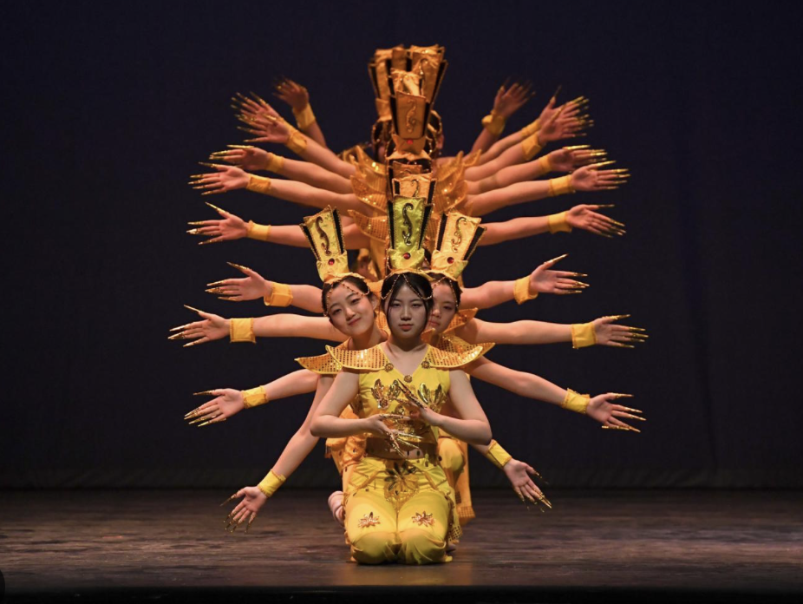
INTRODUCTION
Music transcends boundaries, expressing emotions and traditions across cultures, enriching the global human experience with its universal language.
Its diverse melodies and rhythms unite communities, celebrating cultural diversity while fostering a sense of belonging and shared identity.
From ancient rituals to modern revolutions, music remains a powerful force, shaping societal values, beliefs, and aspirations throughout history.

Slide 4

Literature Survey
Music as Cultural Mirror
Music-driven Social Change
Globalization and Music Fusion
Scholars have examined how music reflects and amplifies the values, beliefs, and social dynamics of a given culture.
Research has demonstrated music's capacity to inspire political movements, challenge social norms, and catalyze broader cultural shifts.
Studies have explored how the cross-pollination of musical styles across borders has led to novel hybrid forms that transcend traditional cultural boundaries.

Slide 5


2
Objectives
1
Understanding how often people listen to music, their preferred genres, and their exposure to diverse musical cultures.
Measure the influence of music on individuals' fashion and dance trends
2

Slide 6
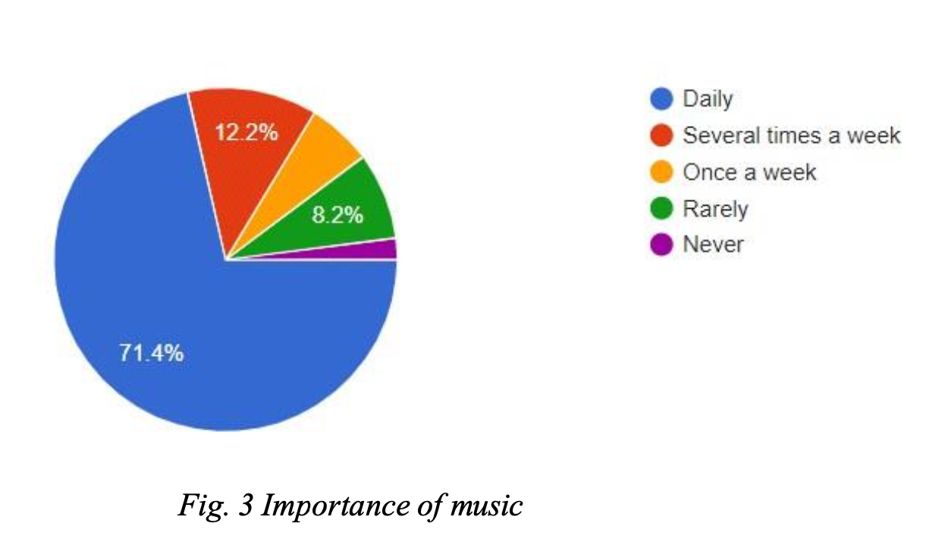
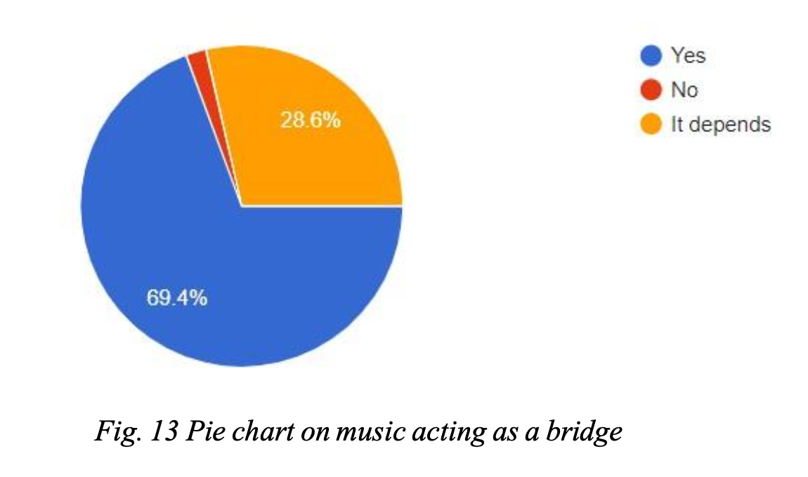
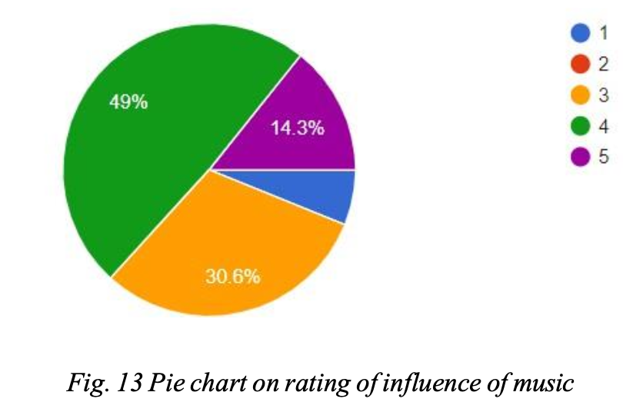

Slide 7
Conceptual Framework
Music
1
New musical styles, genres, and technologies emerge, challenging existing cultural norms.
2
Style
Influenced by music and used to express emotions ,culture identity and social status.
Dance
3
Inspired by different genres of music, providing a rhythmic and emotional framework for movement and showing a culture.

Slide 8

Research Methodology
Qualitative Interviews
Evolution Analysis
In-depth conversations with musicians, cultural critics, and community members to understand their perspectives on music's role in cultural evolution.
By analyzing musical elements like melody, rhythm, and harmony, we could see how these elements have transformed over time, revealing the fingerprint of cultural evolution on music.
Historical Analysis
To explore music's evolution, we journeyed through history. We examined historical documents, recordings, and scholarly works to understand how music has changed across cultures and eras.

Slide 9



Key Findings
Universal language of Music
Impact of Technology on Music
Evolutionary Nature of Music
Music evolves like living things. New musical ideas (variation) are introduced through innovation or borrowing from other cultures. Some ideas become more popular (selection) and are passed on (transmission) to future generations. This is how new genres and styles emerge.
New recording and sharing technologies allow wider music distribution and the creation of entirely new musical styles. The invention of the phonograph, for instance, led to the rise of jazz and blues.
It's found in all cultures and serves various purposes like social bonding, expressing emotions, and storytelling. This universality suggests it might be an innate human trait.

Slide 10

Conclusion
Music's profound influence on cultural evolution is undeniable. By continuing to explore the multifaceted interplay between music and society, researchers can uncover invaluable insights to guide our understanding of how artistic expression and collective identity intertwine to shape the human experience.

Slide 11
Thank you

